Slide 1


Conclusion & Future Work
In conclusion, this project serves as a proof of concept for use of graph theory to predict routes
Within the time constraints of the project, several strengths and weaknesses have been identified about the model
Highly customizable and scalable
Requires more robust processes to calculate weights for model input
Additional analyses suggest that the generated model is not sensitive to changes in input variables, suggesting model stability
Future work includes
Apply model to MENA region
Conduct Regional Influence Survey
Adjust model attributes accordingly
Run model with locations from MENA
Greater sensitivity analyses
Incorporate additional KML data
Further project validation
Collecting data on locations where traffickers have been apprehended
Collecting first-hand experiences to test against model
Notes:
This project serves as a pilot study for using graph models to predict smugglings routes. Using graph theory presents a couple of pros and cons. The strength of our approach is that it is highly customizable and saleable. Using this same approach, we could build models to predict smugglings in the Middle east or Europe. Likewise, by using more nodes in the graph, we could increase the resolution of our model to make precise predictions.
The down side is that our approach requires a human-subjects data collection process in order to gather model inputs. This could be an obstacle depending on the region we are making predictions for.
In the future, we plan to apply our model to make predictions in MENA. Additionally, we will use historical data to try and validate the accuracy of our models predictions.

Slide 2
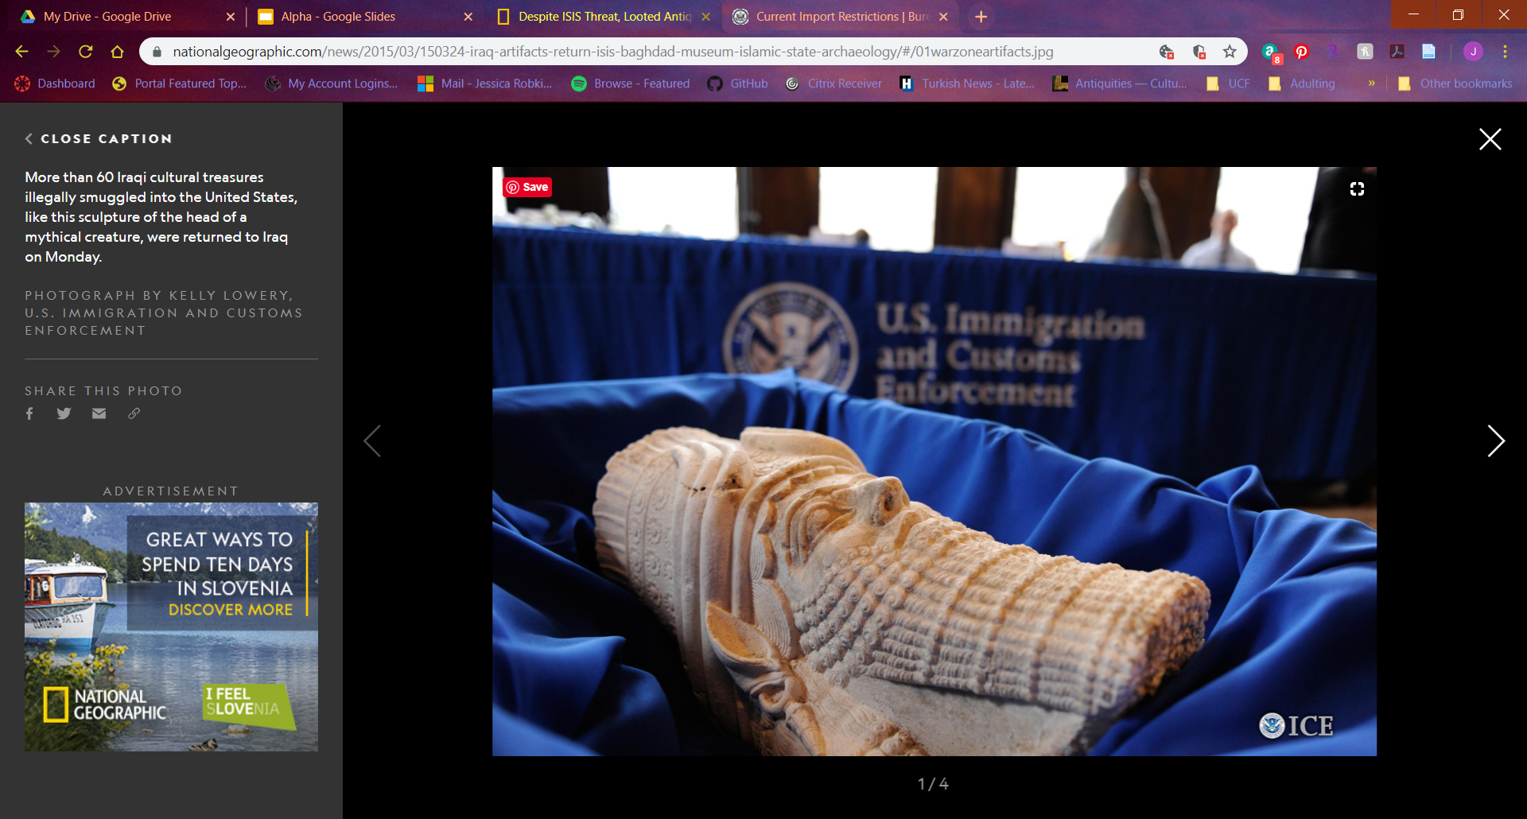


QUESTIONS?
Visit our GitHub repository for more information

Slide 3
REFERENCES
Alderman, K. L. (n.d.). Honor Amongst Thieves: Organized Crime and the Illicit Antiquities Trade. Indiana Law Review, 45, 27.
Barker, A. (2018a, June 5). Tracking the smugglers’ trail of priceless Islamic State loot to art markets in the West. Retrieved September 27, 2019, from ABC News (Australian Broadcasting Corporation website: https://www.abc.net.au/news/2018-06-06/priceless- antiques-looted-by-is-smuggled-into-western-markets/9833554
Barker, A. (2018b, June 6). A one-ton mosaic likely stolen from Syria turns up in the West. It’s the “tip of the iceberg” [Text]. Retrieved September 27, 2019, from ABC News website: https://www.abc.net.au/news/2018-06-06/priceless-antiques-looted-by-is-smuggled-into-western-markets/9833554
Barthélemy, J., & Carletti, T. (2017). An adaptive agent-based approach to traffic simulation. Transportation Research Procedia, 25, 1238–1248. https://doi.org/10.1016/j.trpro.2017.05.142
Barzoukas, G., & Institute for Security Studies (Paris, F. (2017). Drug trafficking in the MENA: The economics and the politics. Retrieved from http://dx.publications.europa.eu/10.2815/972478
Basu, G. (2013). The role of transnational smuggling operations in illicit supply chains. Journal of Transportation Security, 6(4), 315–328. https://doi.org/10.1007/s12198-013-0118-y
Basu, G. (2014). The strategic attributes of transnational smuggling: Logistics flexibility and operational stealth in the facilitation of illicit trade. Journal of Transportation Security, 7(2), 99–113. https://doi.org/10.1007/s12198-013-0132-0
Beittel, J. S. (n.d.). Mexico: Organized Crime and Drug Trafficking Organizations. 35.
Blannin, P. (2017). Islamic State’s Financing: Sources, Methods and Utilisation. 9(5), 11.
Blythe Bowman Proulx. (2013). Archaeological Site Looting in “Glocal” Perspective: Nature, Scope, and Frequency. American Journal of Archaeology, 117(1), 111. https://doi.org/10.3764/aja.117.1.0111
Brodie, N., & Mackenzie, S. (2014). Trafficking Cultural Objects: Introduction. European Journal on Criminal Policy and Research, 20(4), 421–426. https://doi.org/10.1007/s10610-014-9256-4
Brodie, N., & Renfrew, C. (2005). Looting and The World’s Archaeological Heritage: The Inadequate Response. Annual Review of Anthropology, 34(1), 343–361. https://doi.org/10.1146/annurev.anthro.34.081804.120551
Broek, A. C. van den, Schoemaker, R. M., & Dekker, R. J. (2014). Land Border Permeability and Irregular Migration Using Geospatial Intelligence from Satellite Data. 2014 IEEE Joint Intelligence and Security Informatics Conference, 208–211. https://doi.org/10.1109/JISIC.2014.38
Brunsdon, C., & Singleton, A. (2015). Geocomputation: A Practical Primer. https://doi.org/10.4135/9781473916432
Campbell, P. B. (2013). The Illicit Antiquities Trade as a Transnational Criminal Network: Characterizing and Anticipating Trafficking of Cultural Heritage. International Journal of Cultural Property, 20(2), 113–153. https://doi.org/10.1017/S0940739113000015
Casana, J. (2015). Satellite imagery-based analysis of archaeological looting in Syria. Near Eastern Archaeology, 78(3), 142–152.
Casana, & Panahipour. (2014). Satellite-Based Monitoring of Looting and Damage to Archaeological Sites in Syria. Journal of Eastern Mediterranean Archaeology & Heritage Studies, 2(2), 128. https://doi.org/10.5325/jeasmedarcherstu.2.2.0128
Danese, M., Masini, N., Biscione, M., & Lasaponara, R. (2014). Predictive modeling for preventive Archaeology: Overview and case study. Open Geosciences, 6(1). https://doi.org/10.2478/s13533-012-0160-5
Felner, A. (n.d.). Position Paper: Dijkstra’s Algorithm versus Uniform Cost Search or a Case Against Dijkstra’s Algorithm. 5.
Graph Theory Types of Graphs—Javatpoint. (n.d.). Retrieved December 8, 2019, from Www.javatpoint.com website: https://www.javatpoint.com/graph-theory-types-of-graphs
Grayson, G. W. (2014). The Evolution of Los Zetas in Mexico and Central America: Sadism as an Instrument of Cartel Warfare: https://doi.org/10.21236/ADA599872
Greenland, F. (2019). Introduction: New Insights into the Antiquities Market. International Journal of Cultural Property, 26(3), 211–225. https://doi.org/10.1017/S0940739119000237
Inside the hunt for Iraq’s looted treasures. (2019, July 10). Retrieved September 27, 2019, from The Independent website: https://www.independent.co.uk/news/world/middle-east/iraq-archaeology-museum-antiquities-looting-a8996676.html
Jenkins, J. L., Marquardson, J., Proudfoot, J. G., Valacich, J. S., Golob, E., & Nunamaker, J. F. (2013). The Checkpoint Simulation: A Tool for Informing Border Patrol Checkpoint Design and Resource Allocation. 2013 European Intelligence and Security Informatics Conference, 252–255. https://doi.org/10.1109/EISIC.2013.65
Jordan, C. (2016, December 17). New leads on looted Middle Eastern antiquities [Text]. Retrieved September 27, 2019, from TheHill website: https://thehill.com/blogs/congress-blog/foreign-policy/310831-new-leads-on-looted-middle-eastern-antiquities
Latek, M. M., Rizi, S. M. M., Crooks, A., & Fraser, M. (2012). Social Simulations for Border Security. 2012 European Intelligence and Security Informatics Conference, 340–345. https://doi.org/10.1109/EISIC.2012.50
Luke, C., & Kersel, M. (2005). A Retrospective and a Look Forward. Journal of Field Archaeology, 30(2), 191–200. https://doi.org/10.1179/009346905791072323
Madella, M., Rondelli, B., Lancelotti, C., Balbo, A., Zurro, D., Campillo, X. R., & Stride, S. (2014). Introduction to Simulating the Past. Journal of Archaeological Method and Theory, 21(2), 251–257. https://doi.org/10.1007/s10816-014-9209-8
Medel, M., Lu, Y., & Chow, E. (2015). Mexico’s drug networks: Modeling the smuggling routes towards the United States. Applied Geography, 60, 240–247. https://doi.org/10.1016/j.apgeog.2014.10.018
Parcak, S., Gathings, D., Childs, C., Mumford, G., & Cline, E. (2016). Satellite evidence of archaeological site looting in Egypt: 2002–2013. Antiquity, 90(349), 188–205. https://doi.org/10.15184/aqy.2016.1
Parks, S., Mcanany, P. A., & Murata, S. (2006). The Conservation of Maya Cultural Heritage: Searching for Solutions in a Troubled Region. Journal of Field Archaeology, 31(4), 425–432. https://doi.org/10.1179/009346906791071846
Rodríguez-Puente, R., & Lazo-Cortés, M. S. (2013). Algorithm for shortest path search in Geographic Information Systems by using reduced graphs. SpringerPlus, 2(1), 291. https://doi.org/10.1186/2193-1801-2-291
Rose-Greenland, F. (2014). Looters, collectors and a passion for antiquities at the margins of Italian society. Journal of Modern Italian Studies, 19(5), 570–582. https://doi.org/10.1080/1354571X.2014.962256
Samuel, S. (2018, March 19). It’s Disturbingly Easy to Buy Iraq’s Archeological Treasures. Retrieved September 27, 2019, from The Atlantic website: https://www.theatlantic.com/international/archive/2018/03/iraq-war-archeology-invasion/555200/
Sellers, W. I., Hill, R. A., & Logan, B. S. (2007). An agent-based model of group decision making in baboons. Philosophical Transactions of the Royal Society B: Biological Sciences, 362(1485), 1699–1710. https://doi.org/10.1098/rstb.2007.2064
Sørensen, M. L. S., & Viejo-Rose, D. (Eds.). (2015). War and Cultural Heritage: Biographies of Place. New York, NY: Cambridge University Press.
Stealing from history: The looting and destruction of Iraqi and Syrian heritage concern us all. (n.d.). Retrieved April 2, 2019, from The National website: https://www.thenational.ae/arts-culture/stealing-from-history-the-looting-and-destruction-of-iraqi-and-syrian-heritage-concern-us-all-1.308011
Sullivan, B. L. (n.d.). Stolen artifacts finding way into the world’s art markets. Retrieved September 27, 2019, from Baltimoresun.com website: https://www.baltimoresun.com/bal-te.fbi22apr22-story.html
Swann, S. (2019, May 2). “Loot-to-order” antiquities sold on Facebook. BBC News. Retrieved from https://www.bbc.com/news/world-middle-east-47628369
Visconti, A. (n.d.). Professor of Criminal Law, University of Naples II, Italy; Visiting Professor, Queen Mary University of London, UK; ISPAC Deputy Chair and Director. 210.
Wang, X. Z. (2018). The Comparison of Three Algorithms in Shortest Path Issue. Journal of Physics: Conference Series, 1087, 022011. https://doi.org/10.1088/1742-6596/1087/2/022011
Xue, G., Li, Z., Zhu, H., & Liu, Y. (2009). Traffic-Known Urban Vehicular Route Prediction Based on Partial Mobility Patterns. 2009 15th International Conference on Parallel and Distributed Systems, 369–375. https://doi.org/10.1109/ICPADS.2009.129

